Slide 1
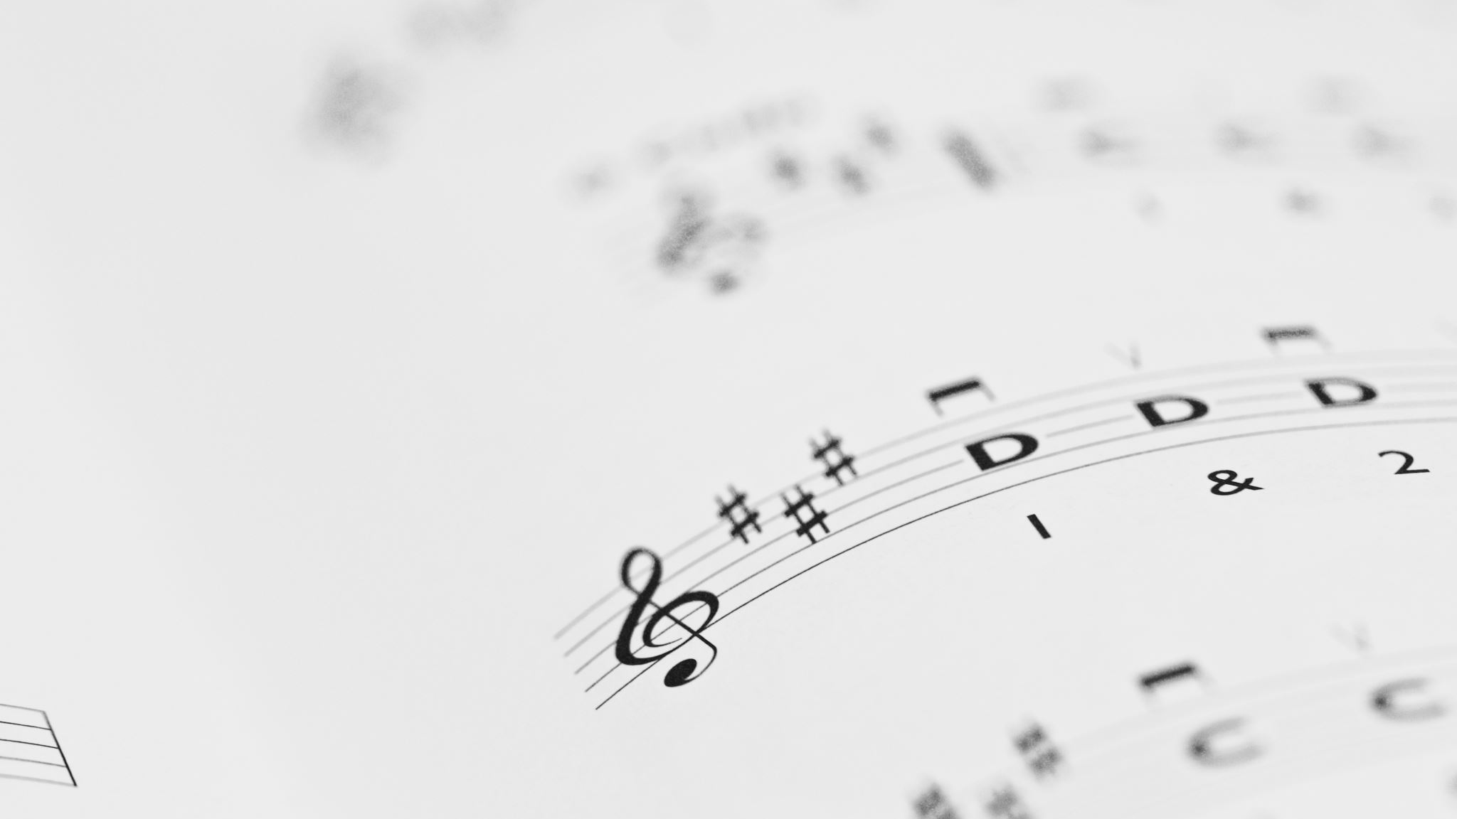
optical music recognition
Group 16
Instructor: Dr. Dinh Viet Sang

Slide 2
Members
Vu Cong Duy - 20176737
Dao Hong Quan - 20176850
Tran Cong Minh - 20176825
Tran Thi Hang - 20176748
Duong Thi Hue - 20176772

Slide 3
Content
Introduction
Theoretical background
Implementation
Result
Overview

Slide 4
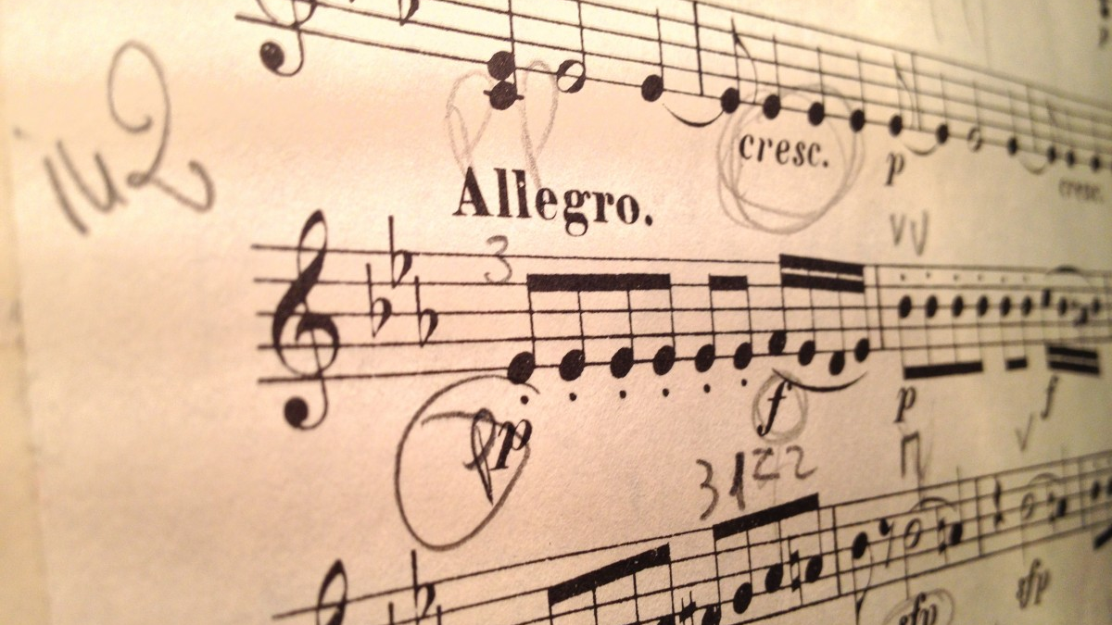
Introduction
Reading and understanding music sheets is one of the most straightforward examples of optical tasks that can be improved with the help of computers
Implement and improve an existing OMR neural network project to read and translate images of single-staff scores

Slide 5
Tasks
Vu Cong Duy:
Implementing models
CTC
Dao Hong Quan:
Data preprocessing
CRNN
Tran Cong Minh:
Output conversion
Optimization
Duong Thi Hue:
Evaluation metrics
CNN
Tran Thi Hang:
Evaluation metrics
RNN

Slide 6

Original work
Based on Jorge Calvo-Zaragoza and David Rizo’s research paper “End-to-End Optical Music Recognition of Monophonic Scores”
Rewrote the code using Pytorch and implemented multitask learning

Slide 7
Variables
There are two types of input for each sample.
The first one is a basic png file of the score.
The other is the jpg file containing the distorted version.
Two types of output, both are a sequence of symbols representing the image.

Slide 8

Theoretical background

Slide 9
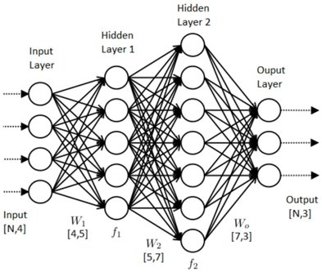
Neural Network
A traditional Artificial Neural Network:
Input Nodes (input layer)
Hidden nodes (hidden layer)
Output Nodes (output layer)
Connections and weights
Activation function

Slide 10
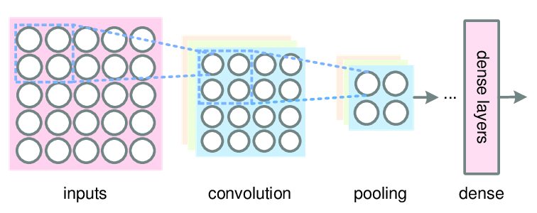
Convolutional Neural Network
The model’s number of nodes may grow exponentially with the number of layers, which leads to numerous problems
The main difference between CNN and ANN is the convolutional layer.
Each convolutional layer is usually accompanied by a pooling layer
The information will be extracted for meaning and reduced in size

Slide 11
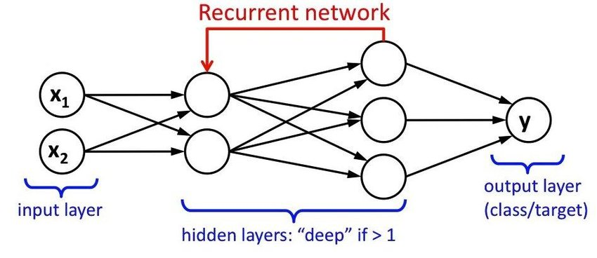
Recurrent Neural Network
Like CNN, RNN was constructed to solve certain problems that the traditional neural network falls short of.
The output of a node will be used as input for previous layers or nodes of the same layer.

Slide 12
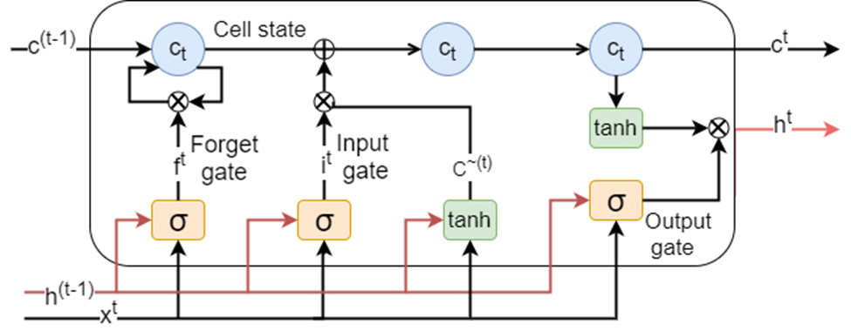
Recurrent Neural Network
Long Short-Term Memory (LSTM) architecture

Slide 13
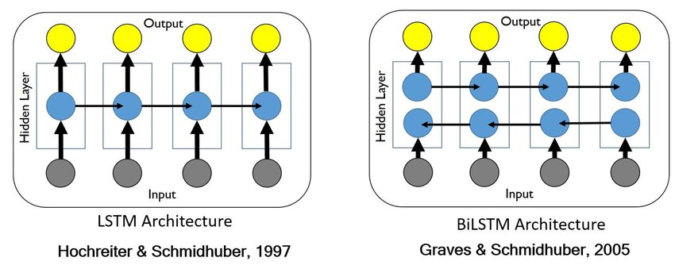
Recurrent Neural Network
An extension of LSTM is the bidirectional LSTM, or biLSTM

Slide 14
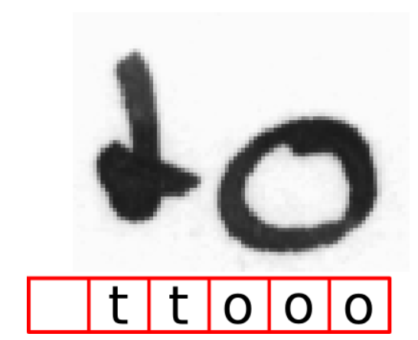
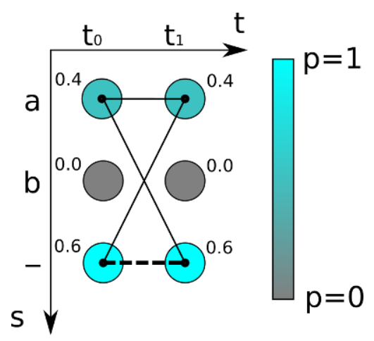
Connectionist Temporal Classification Loss
In CTC, the task is treated as a multi-class prediction problem, with target cardinality equal to the alphabet plus one blank token.
Since the output is a matrix of probability between each element and each of the classes, the ground truth score is calculated by summing the probabilities of all combination sequences that return the ground truth.

Slide 15
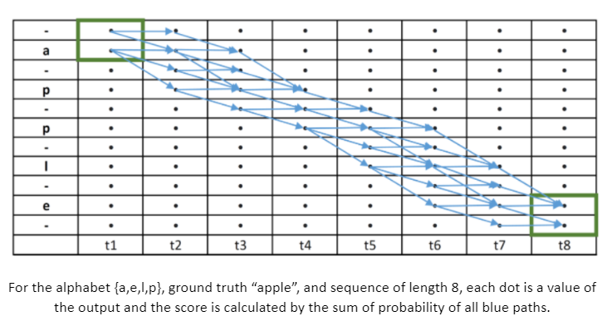
CTC Example

Slide 16

Dataset

Slide 17
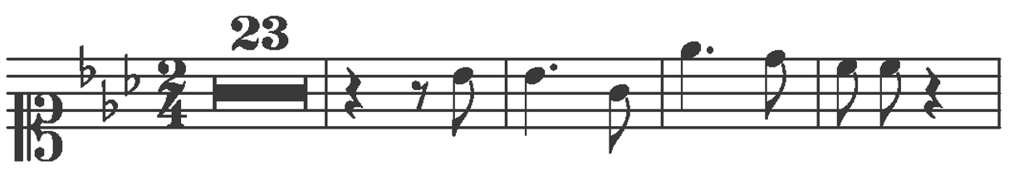
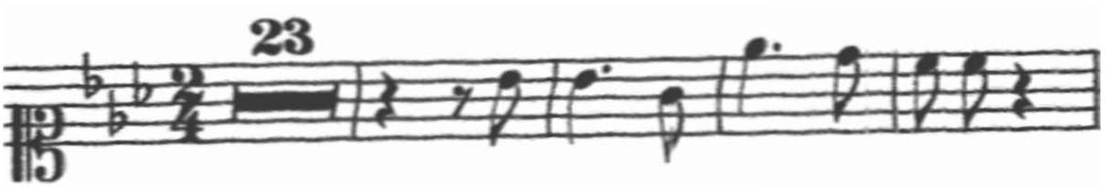
PrIMuS Dataset
Consists of only single-staff, monophonic scores
We chose the updated dataset, which includes a distorted version for each of the images

Slide 18
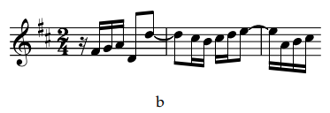
Images

Slide 19
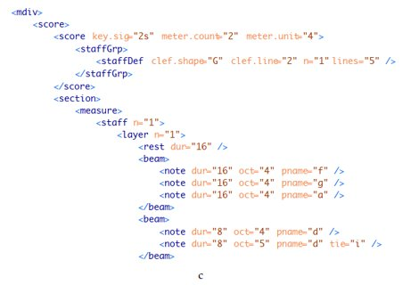
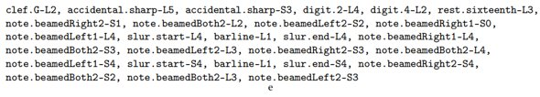

Labels

Slide 20

Implementation

Slide 21

Data preprocessing
OpenCV 4.0.1 is used to open and scale images
The images vary in length and need to be padded to the length of the largest one
The label of each image needs to be converted to a sequence of numerical values

Slide 22
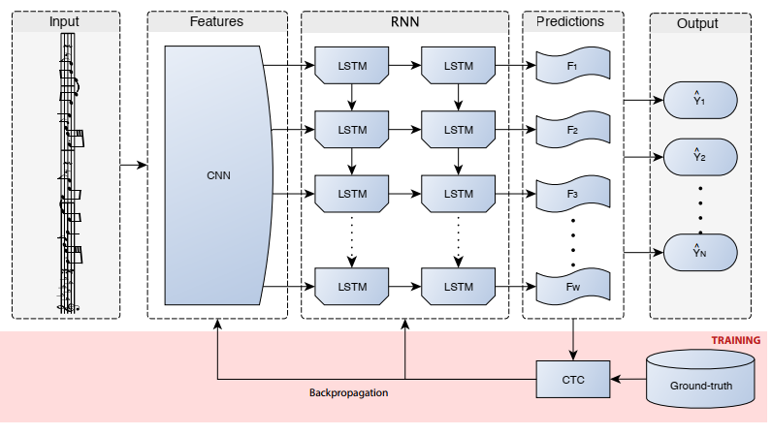
CRNN Model
CNN and RNN architectures are combined to make the Convolutional Recurrent Neural Network (CRNN)

Slide 23
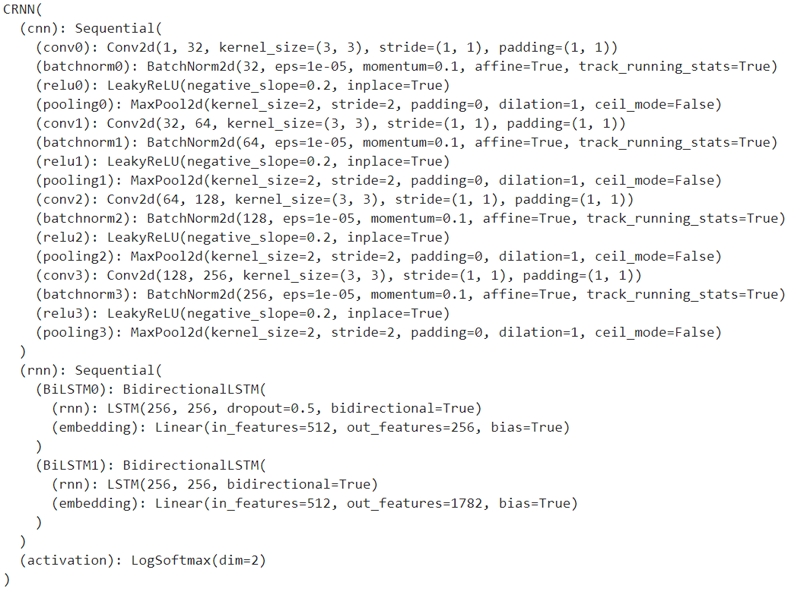
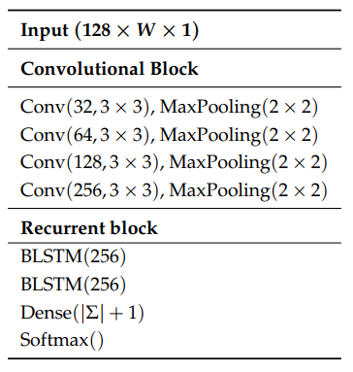
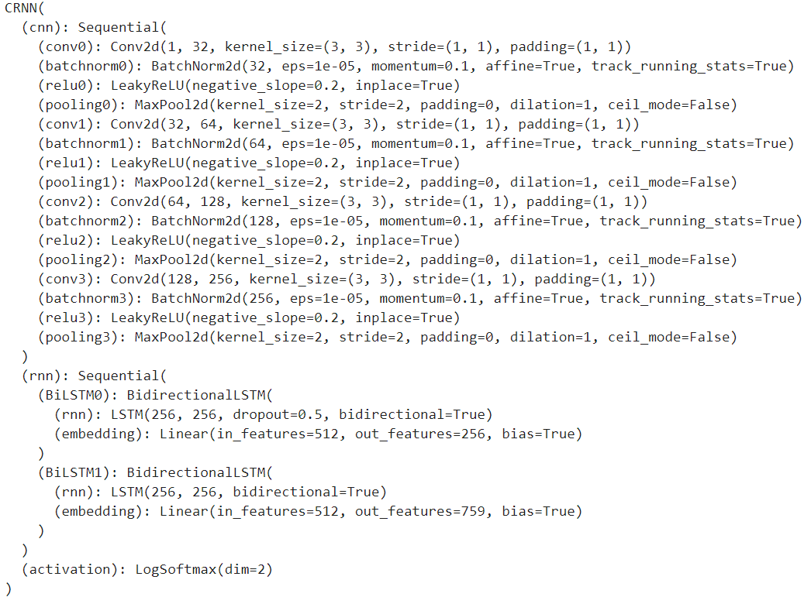
CRNN Model
For optimization, we used the Adam algorithm.
There are two distinct models: semantic and agnostic recognition
Agnostic model Sematic model

Slide 24
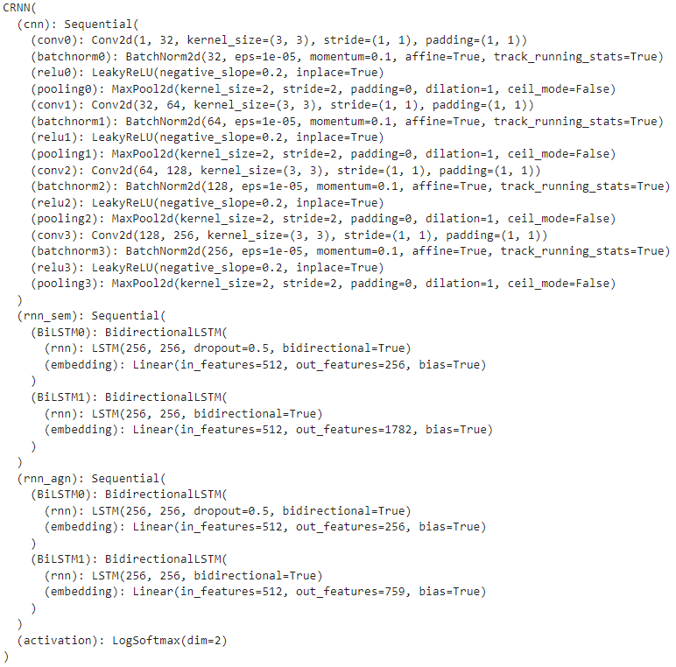
Multitask Learning
We hypothesized that both recognition models will benefit from the same feature extraction layers
The parameters of this model are not different
Prone to overfitting

Slide 25

Result

Slide 26
Evaluation Metrics
Accuracy(%): Sequences without error
Symbol error rate(%): Modifications required to produce ground truth from prediction
Symbol confusion rate(%): Modifications performed on both the symbols and the sequence.

Slide 27
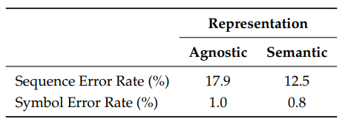
Normal Dataset
We could not produce the results as good as the baseline model, due to the difference in batch size (4 vs 16) and epochs (5 vs 16)

Slide 28
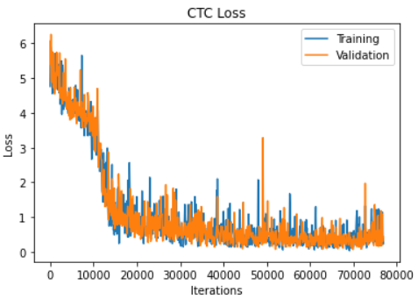
Normal Dataset
Semantic Result
Accuracy: 24.24%
Symbol error rate: 10.14%
Symbol confusion rate: 4.17%

Slide 29
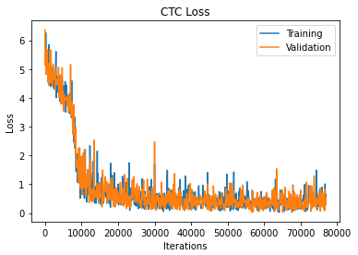
Normal Dataset
Agnostic Result
Accuracy: 18.98%
Symbol error rate: 14.13%
Symbol confusion rate: 8.41%

Slide 30
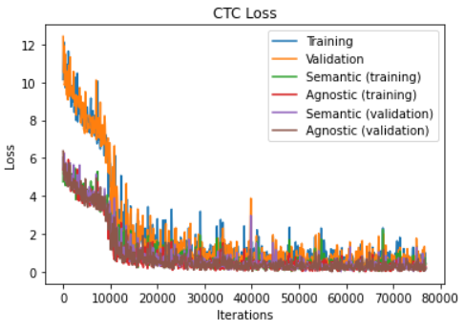
Normal Dataset
Multitask learning
Accuracy: 20.29%
Semantic accuracy: 27.67%
Semantic Symbol error rate: 9.40%
Semantic Symbol confusion rate: 3.91%
Agnostic accuracy: 32.15%
Agnostic symbol error rate: 9.13%
Agnostic symbol confusion rate: 4.89%

Slide 31
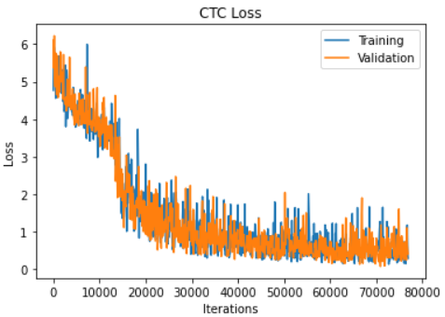
Distorted Dataset
Semantic Result
Accuracy: 17.96%
Symbol error rate: 14.20%
Symbol confusion rate: 7.50%

Slide 32
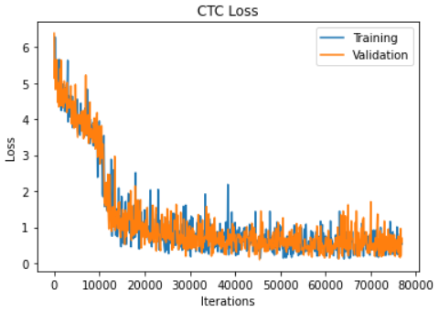
Distorted Dataset
Agnostic Result
Accuracy: 8.51%
Symbol error rate: 18.20%
Symbol confusion rate: 12.88%

Slide 33
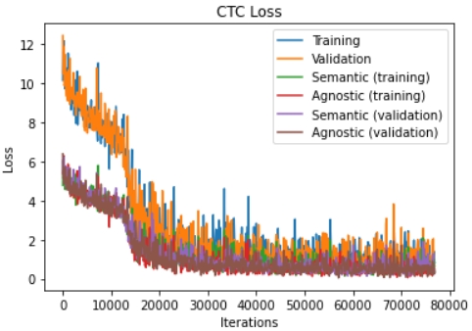
Distorted Dataset
Multitask learning
Accuracy: 6.17%
Semantic accuracy: 14.01%
Semantic Symbol error rate: 15.15%
Semantic Symbol confusion rate: 6.99%
Agnostic accuracy: 14.29%
Agnostic symbol error rate: 14.94%
Agnostic symbol confusion rate: 9.74%

Slide 34

Thanks for listening

